Slide 1
Star craft 2 bot (ubunta)
(bot is dead rigt now)

Slide 2
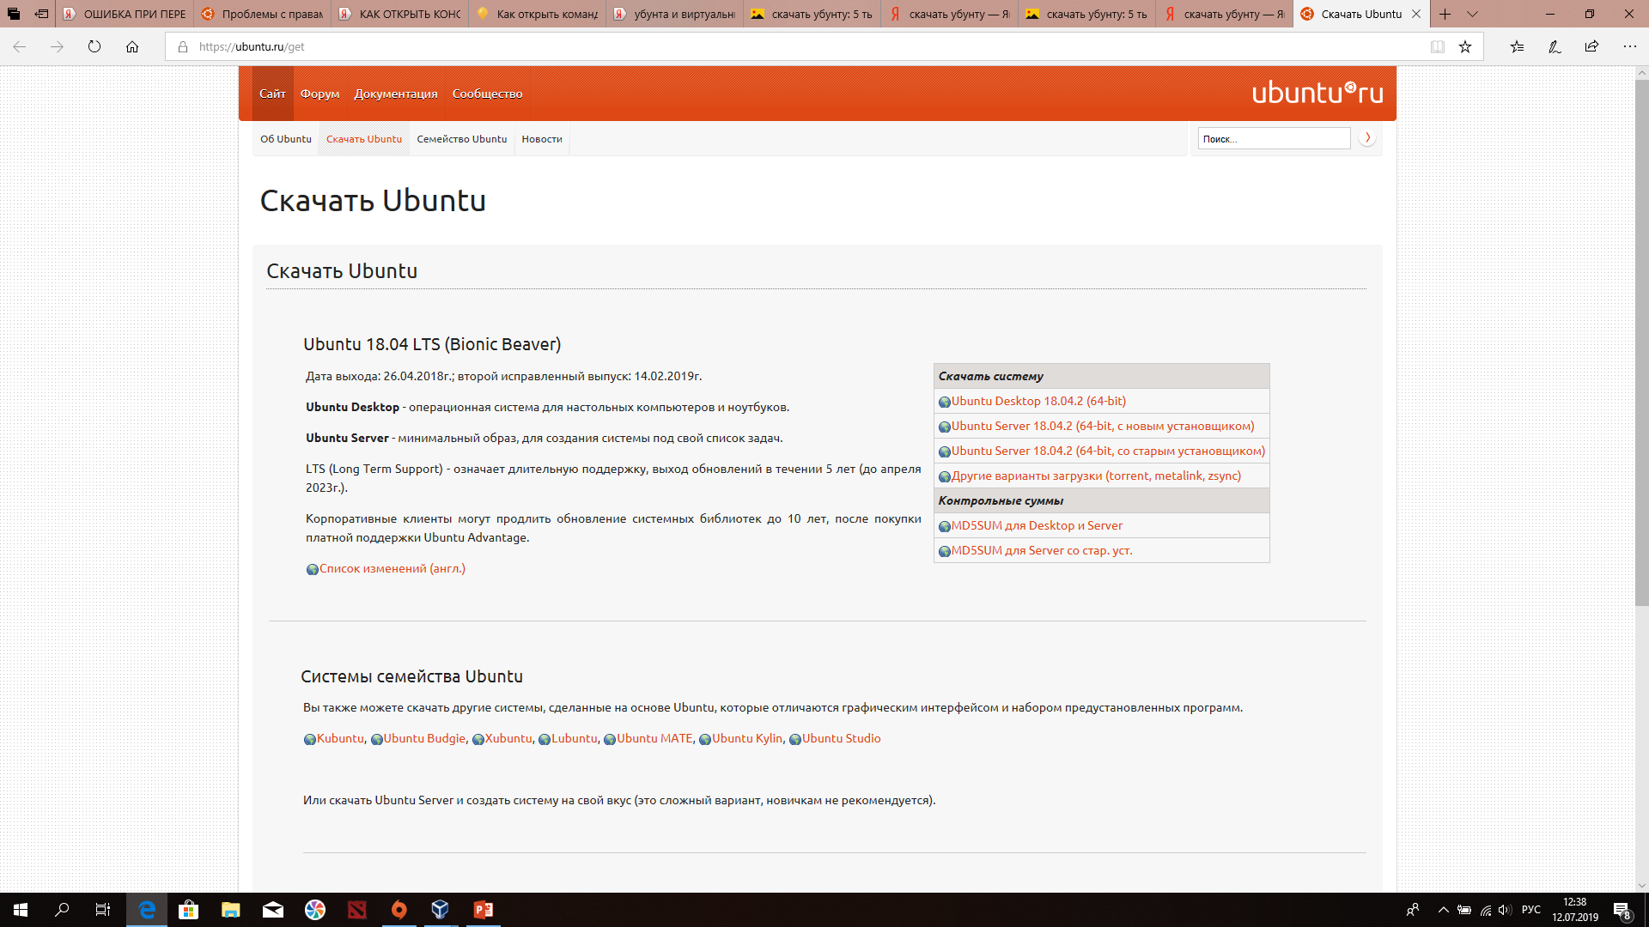
What you shold do?
1) You need to download distributive of ubunta and virtual box.
Кликаем сюда

Slide 3
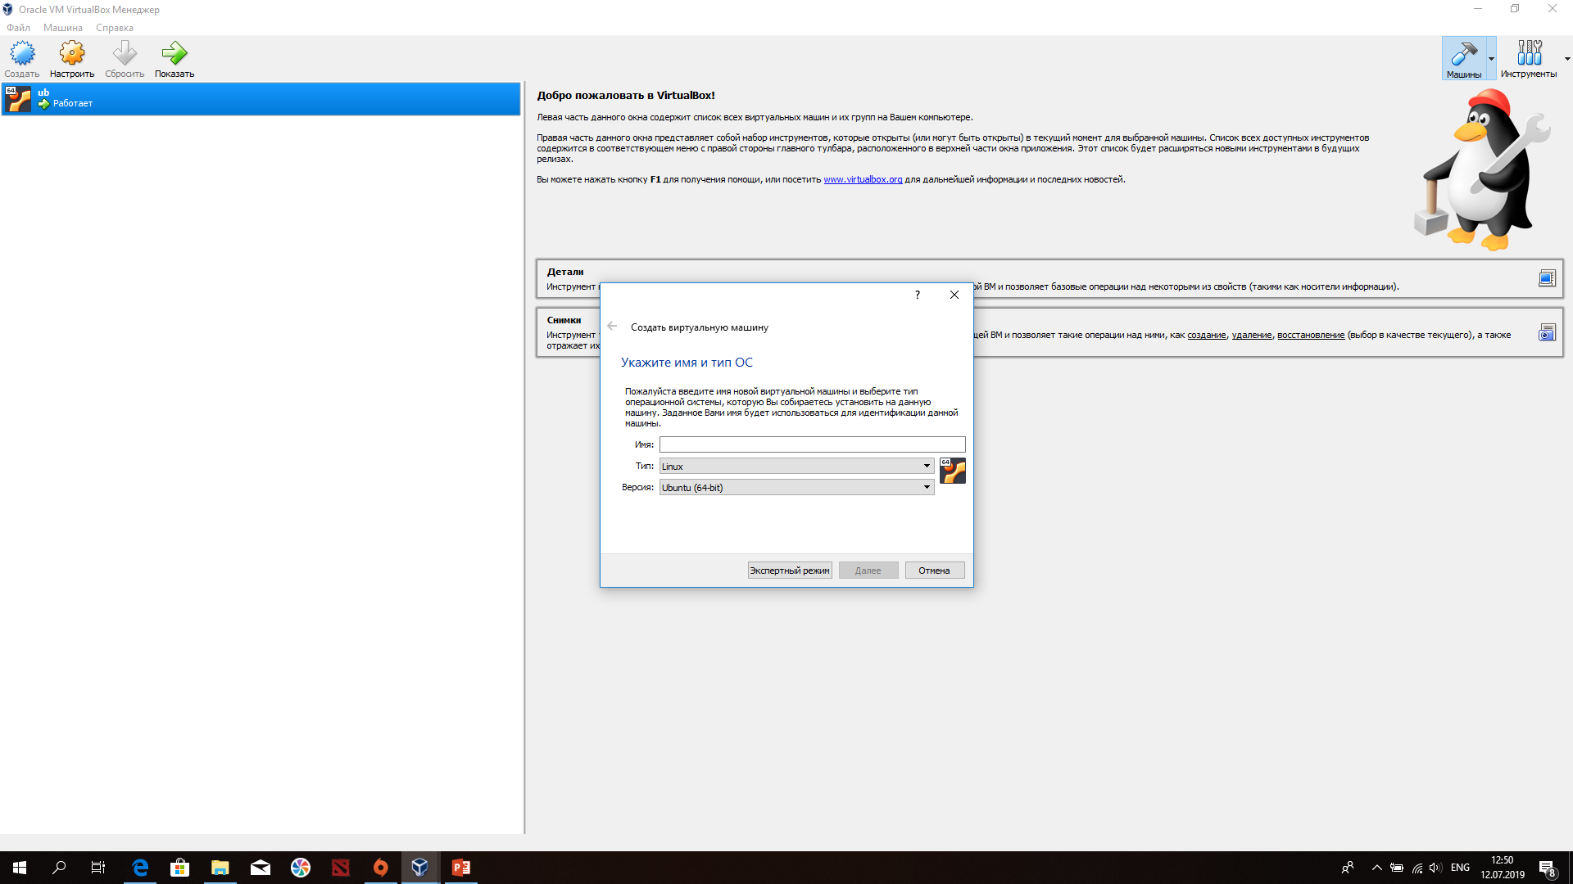
What should you do?
2) create your virtual disk

Slide 4
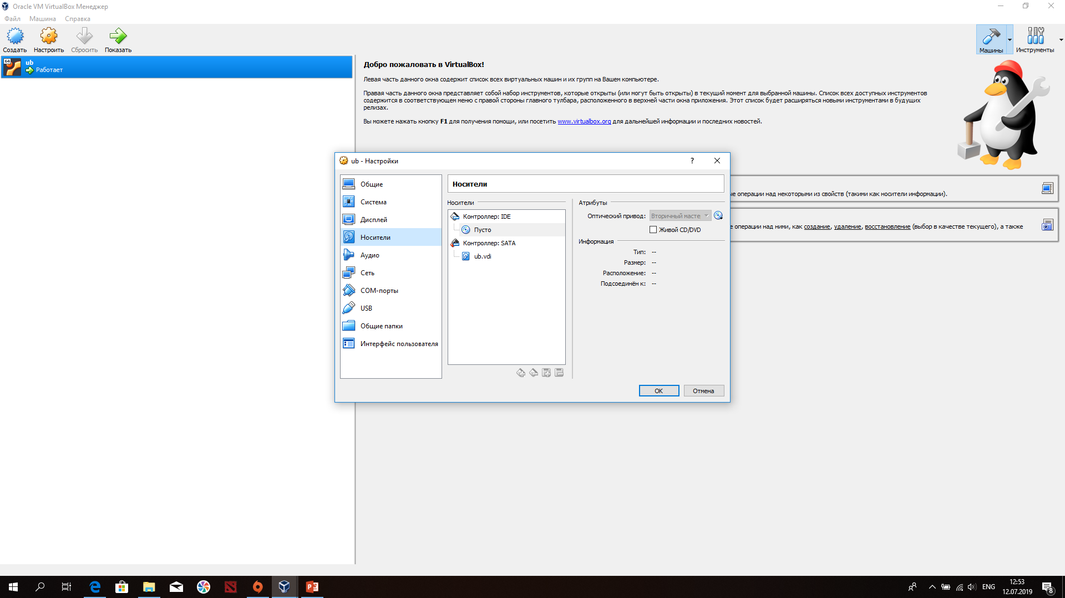
What should you do?
3) Choose the right ide, its very important!

Slide 5
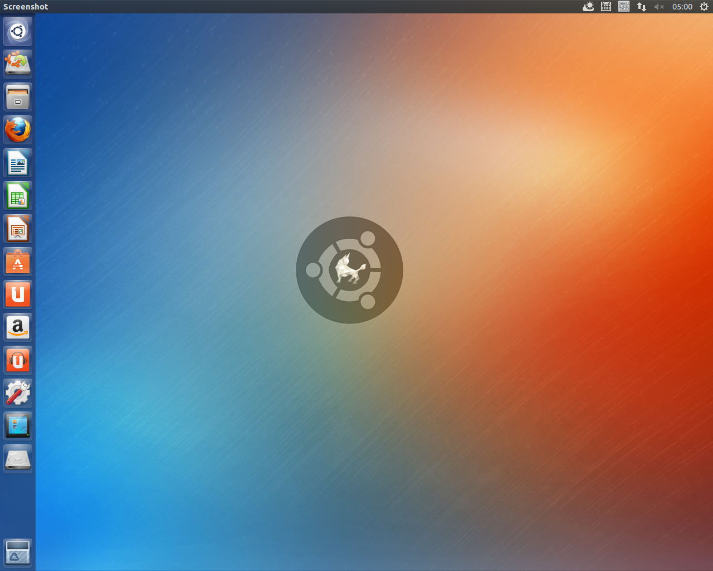
Congratulations

Slide 6
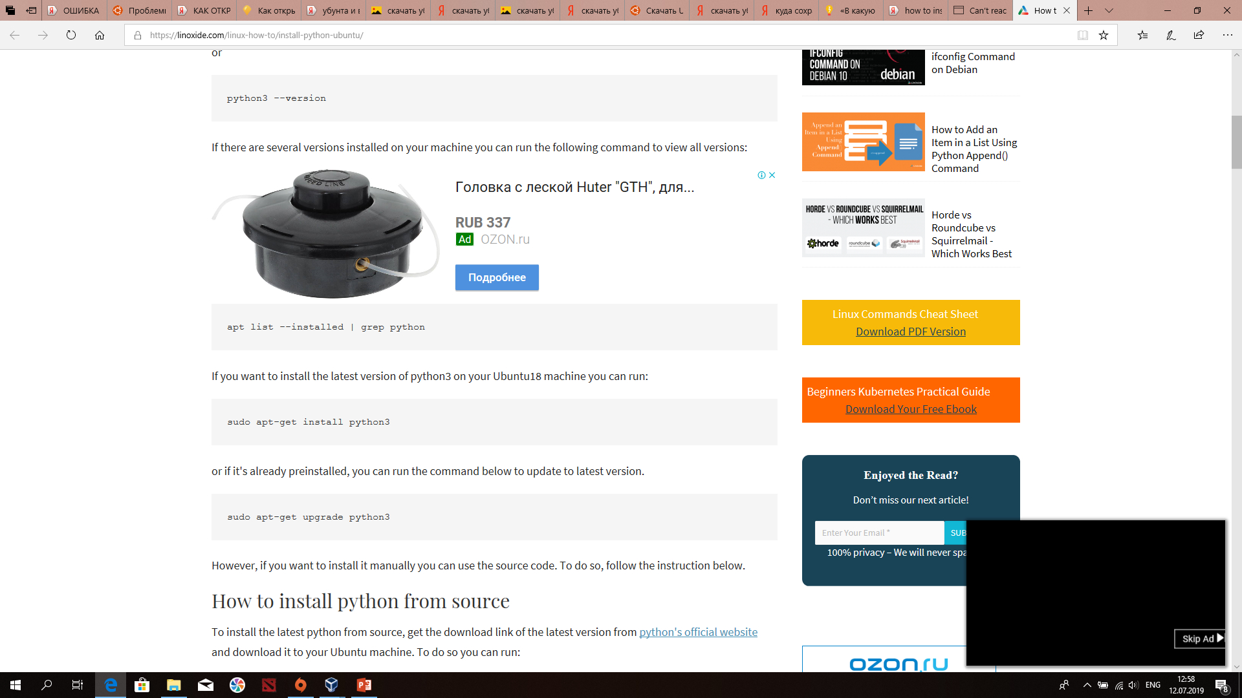
Download python with console

Slide 7

Download sc2 and wine

Slide 8
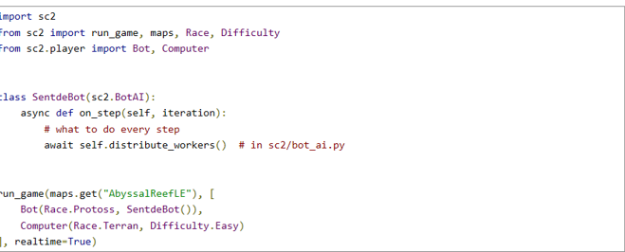
Code

Slide 9

The end

